Slide 1

WK05: SQL Databases
PPOL 5206 – Spring 2025

Slide 2

Previously … SQL Tables
Variables vs observations
Types of data
Big Six SQL clauses
SELECTing information from a table
Using retrieved information to guide analysis

Slide 3
Today’s Agenda
Relational Databases vs Tables
Normalization
Data Modeling
Joins
Temporary Tables
Databases vs Analytics

Slide 4
Relational Databases
Definition:
A relational database (RDBMS) is a structured system for storing, organizing, and managing data using relations (tables). It follows the relational model, where data is stored in tables that are connected through relationships using keys (primary and foreign).
Key Features of Relational Databases:
Data is stored in tables (also called relations).
Tables have columns (attributes) and rows (records).
Relationships between tables are established using keys.
SQL (Structured Query Language) is used to interact with the database.
Follows ACID properties (Atomicity, Consistency, Isolation, Durability) for data reliability.

Slide 5
Tables
Definition:
A table is a single entity inside a relational database that contains structured data in rows and columns.
Structure of a Table:
Tables store data but do not inherently show relationships
A single table can exist without relationships (like an Excel spreadsheet).
However, relational databases connect tables through keys to provide structure and efficiency.
Student_ID | Name | Course | Grade
101 | Alice | SQL | A
102 | Bob | Python | B
103 | Charlie | SQL | A

Slide 6
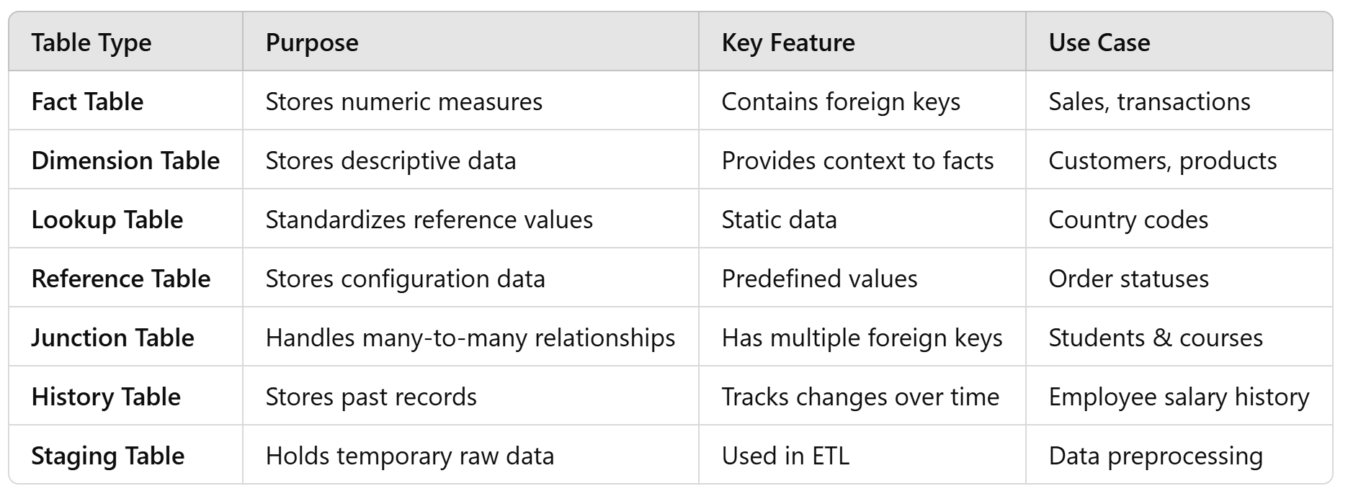
Types of Tables

Slide 7
Databases vs. Tables
Feature | Database | Table
Definition | A collection of tables and relationships | A single structure storing records
Scope | Includes tables, views, indexes, constraints | Only holds structured records
Relationships | Connects tables via foreign keys | Usually stands alone
Example | University Database (Students, Courses, Professors) | Students Table (Only student info)

Slide 8
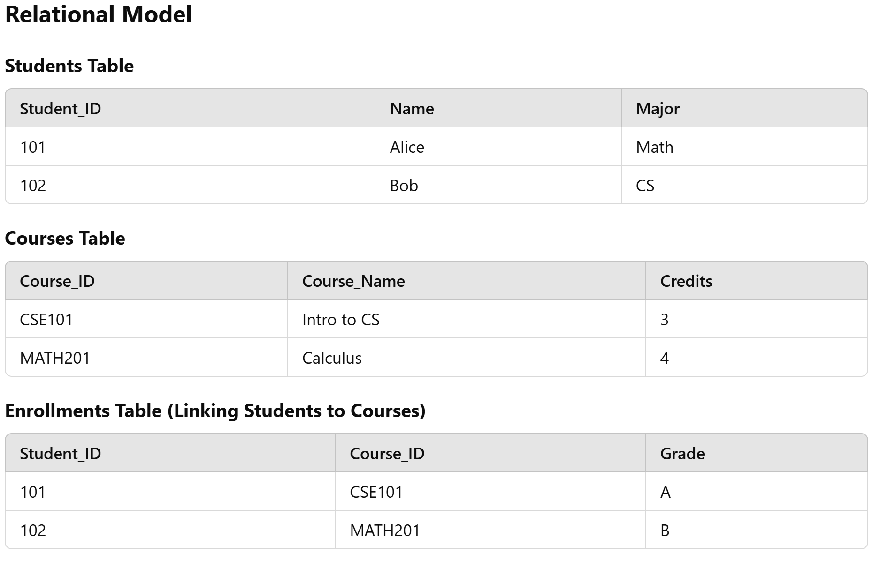
How Relational Databases Use Tables (University Example)
A single table is not enough to manage students, courses, and professors efficiently. Instead, a relational database organizes data into multiple tables:

Slide 9

Why Use a Relational Model Instead of One Large Table?
Avoids Redundancy: Each piece of data appears only once
Maintains Consistency: Updates happen in one place instead of multiple rows
Improves Performance: Queries run faster when data is properly structured

Slide 10
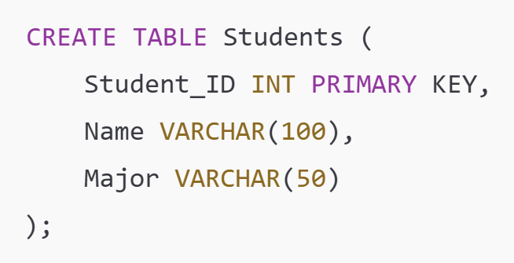
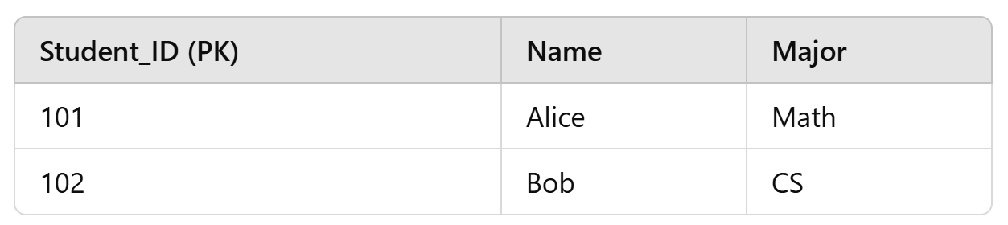
Primary Key
Definition:
A Primary Key is a column (or a set of columns) that uniquely identifies each row in a table.
Each table must have exactly one primary key.
Characteristics:
Uniqueness: No duplicate values are allowed.
Not Null: A primary key cannot have NULL values.
Each table must have one and only one primary key.

Slide 11
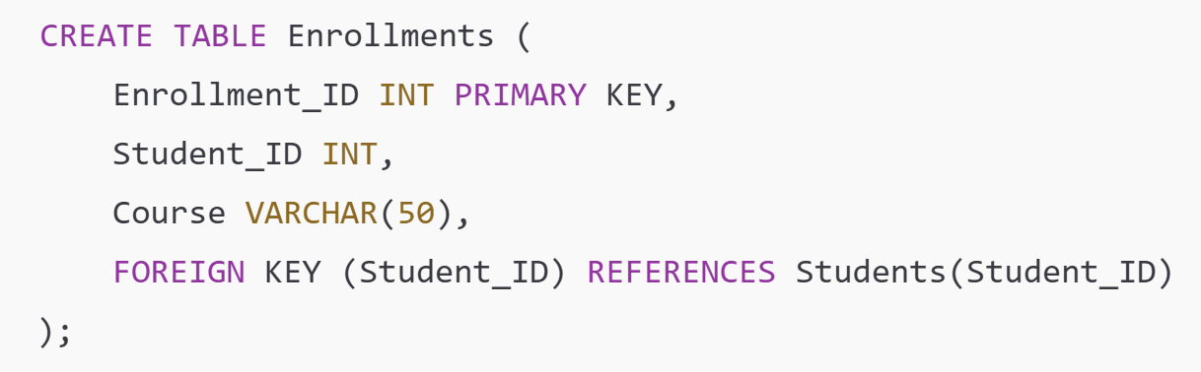
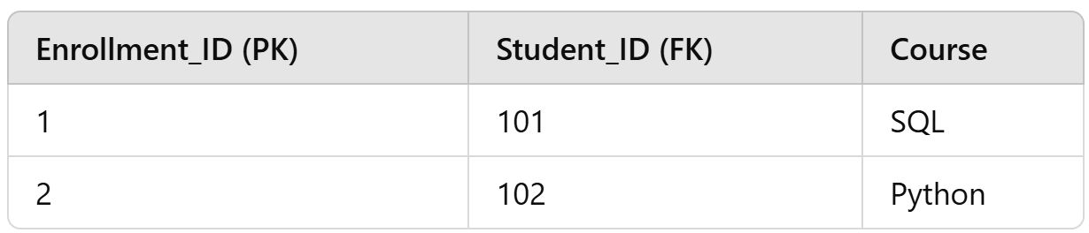
Foreign Key
Definition:
A Foreign Key is a column that creates a link between two tables by referencing the Primary Key of another table.
Characteristics:
Enforces referential integrity
The foreign key must match an existing primary key value in the referenced table
Helps connect multiple tables in relational databases.

Slide 12
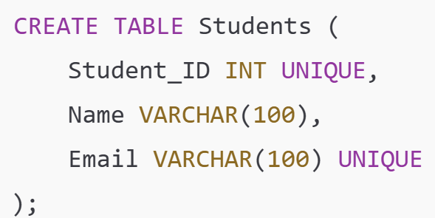
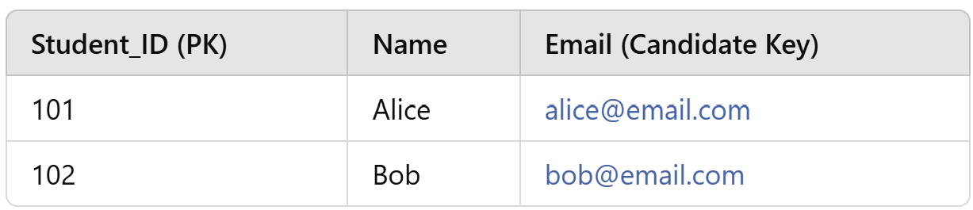
Candidate Key
Definition:
A Candidate Key is any column (or combination of columns) that can uniquely identify a record. A table can have multiple candidate keys, but only one primary keyCharacteristics:
Note: One of the candidate keys is chosen as the primary key, while the rest remain as unique constraints.

Slide 13
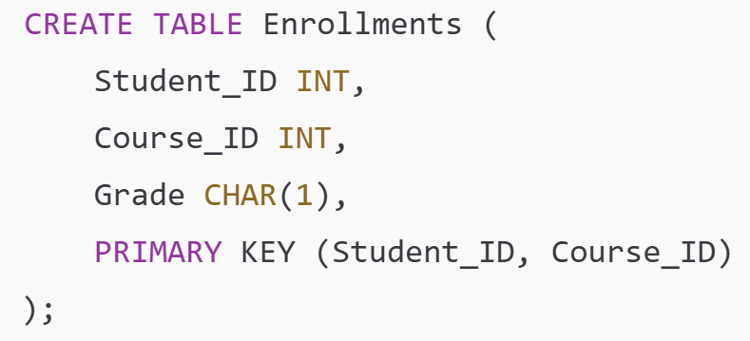
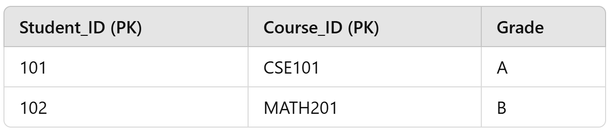
Composite Key
Definition:
A Composite Key is a primary key that consists of multiple columns instead of just one.Characteristics:
Why Use Composite Keys?
Used when a single column is not enough to uniquely identify a row.
Common in junction tables (many-to-many relationships).

Slide 14
Normalization
A theory of table creation
Common Source: A Comprehensive Guide to Database Normalization with Examples - Visual Paradigm Guides

Slide 15
Normalization Theory
It involves dividing a database into tables and establishing relationships between them
Relational databases should follow structured principles to ensure data consistency
A set of rules and guidelines that help organize data efficiently and prevent common data anomalies:
Update
Insertion
Deletion
The stages of normalization (Normal forms) are cumulative
Tradeoffs:
Consistency vs performance

Slide 16
Why Normalize Tables
Data Integrity: Normalization helps maintain data accuracy and consistency by reducing redundancy. When data is stored in a non-repetitive manner, it is less prone to errors.
Efficient Storage: Normalized databases tend to occupy less storage space as duplicate data is minimized. This reduces the overall cost of storage.
Query Optimization: Queries become more efficient in normalized databases because they need to access smaller, well-structured tables instead of large, denormalized ones.
Flexibility: Normalized databases are more flexible when it comes to accommodating changes in data requirements or business rules.

Slide 17
Update Anomalies
Student_ID | Name | Course | Instructor | Instructor_Email
101 | Alice | SQL | Prof. Smith | smith@university.edu
102 | Bob | Python | Prof. Jones | jones@university.edu
103 | Charlie | SQL | Prof. Smith | smith@university.edu
If Prof. Smith's email changes, we must update multiple rows.
If we forget to update all occurrences, we now have inconsistent data.
The solution is to normalize by creating a separate table for instructors.

Slide 18
Insertion Anomalies
Student_ID | Name | Course | Instructor | Instructor_Email
101 | Alice | SQL | Prof. Smith | smith@university.edu
102 | Bob | Python | Prof. Jones | jones@university.edu
103 | Charlie | SQL | Prof. Smith | smith@university.edu
Suppose we want to add a new instructor who hasn’t yet taught a course.
If the Instructor column is tied to students, we cannot insert an instructor unless a student is enrolled in their class.
This prevents data entry until another condition is met

Slide 19
Deletion Anomalies
Student_ID | Name | Course | Instructor | Instructor_Email
101 | Alice | SQL | Prof. Smith | smith@university.edu
102 | Bob | Python | Prof. Jones | jones@university.edu
103 | Charlie | SQL | Prof. Smith | smith@university.edu
If we delete Bob’s data, we lose all information on Prof. Jones
We don’t want to delete instructor’s data just because a student withdrew

Slide 20
Summary of Three Anomalies
Anomaly | Problem | Cause | Solution
Update Anomaly | Inconsistent data when updating multiple entries | Redundant data across multiple rows | Separate repeated data into different tables
Insertion Anomaly | Can't add data without another dependent record | Unnormalized tables with dependent relationships | Allow independent insertion by splitting tables
Deletion Anomaly | Deleting a record removes unintended data | Storing unrelated data in the same table | Separate logically distinct entities

Slide 21
First Normal Form: 1NF
Definition: A table is in 1NF if all the columns contain atomic (indivisible) values and each row is unique.
Issues it solves:
Eliminates duplicate rows.
Ensures each column contains values of a single type.
Simplifies the table structure by removing repeating groups or arrays.

Slide 22
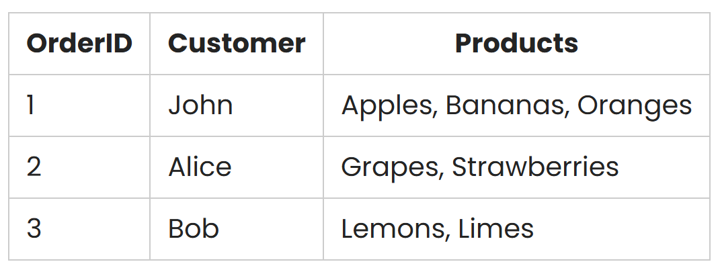
First Normal Form: Problem
This table violates 1NF because the Products column contains a list of items

Slide 23
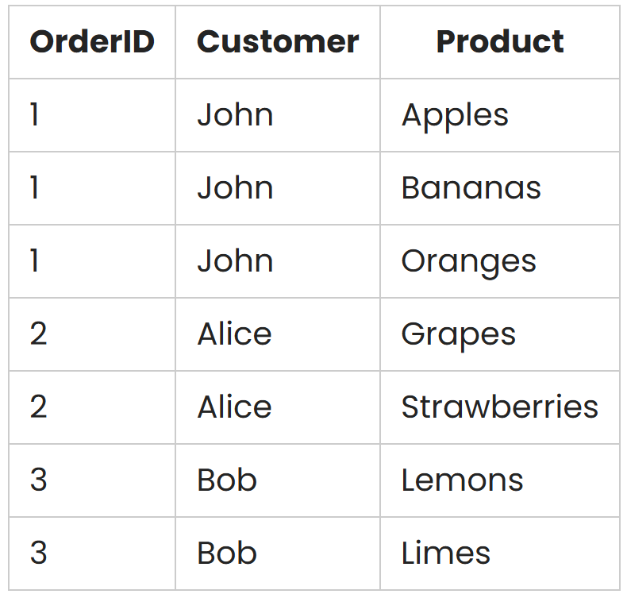
First Normal Form: Solution
To bring it to 1NF, we split the products into separate rows:

Slide 24
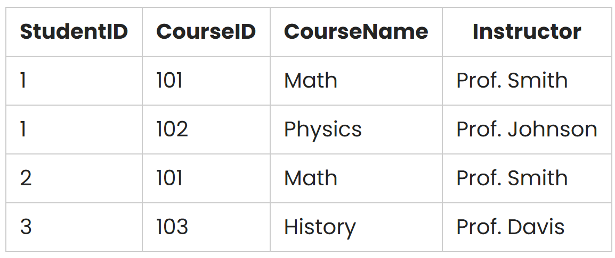
Second Normal Form: Problem
This table violates 2NF because the Instructor attribute depends on both StudentID and CourseID

Slide 25
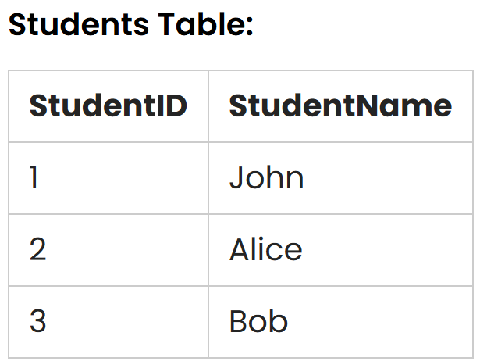
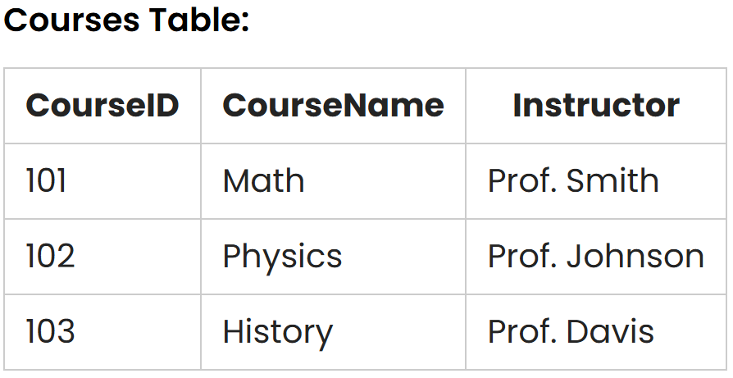
Second Normal Form: Solution
To achieve 2NF, we split the table into two separate tables:

Slide 26
And more…
First Normal Form (1NF): Ensures that each column in a table contains atomic, indivisible values. There should be no repeating groups, and each column should have a unique name.
Second Normal Form (2NF): Building on 1NF, 2NF eliminates partial dependencies. A table is in 2NF if it’s in 1NF and all non-key attributes are functionally dependent on the entire primary key.
Third Normal Form (3NF): Building on 2NF, 3NF eliminates transitive dependencies. A table is in 3NF if it’s in 2NF and all non-key attributes are functionally dependent on the primary key, but not on other non-key attributes.
Boyce-Codd Normal Form (BCNF): A stricter version of 3NF, BCNF ensures that every non-trivial functional dependency is a superkey. This means that no partial dependencies or transitive dependencies are allowed.
Fourth Normal Form (4NF): 4NF deals with multi-valued dependencies, where an attribute depends on another attribute but is not a function of the primary key.
Fifth Normal Form (5NF) or Project-Join Normal Form (PJNF): These forms deal with cases where a table is in 4NF, but there are join dependencies that can be further optimized.
Explanations and Examples:
A Comprehensive Guide to Database Normalization with Examples - Visual Paradigm Guides

Slide 27
Pros of Higher Levels of Normalization
Reduced Redundancy: Higher normalization reduces data redundancy, meaning less duplicate data is stored in the database, which can save storage space.
Improved Data Integrity: Normalization enforces data consistency and integrity, reducing the likelihood of anomalies and inconsistencies.
Easier to Maintain: With less redundancy, updates, deletions, and insertions are simpler and less prone to error, as they typically need to be made in fewer places.
Better Data Structure: A well-normalized database often results in a clearer, more understandable structure, which can simplify querying and reporting.

Slide 28
Cons of Higher Levels of Normalization
Complexity: Higher levels of normalization can lead to increased complexity in the database design, making it more difficult to understand and manage.
Performance Impact: More tables mean more joins in queries, which can slow down data retrieval, especially in large databases or databases with high transaction volumes.
Difficult to Optimize: Highly normalized databases can be more challenging to optimize for performance, as the structure can be rigid and less amenable to tuning.
Operational Overhead: With more tables and relationships to manage, the operational overhead, in terms of both maintenance and development, can increase.

Slide 29

Data Modeling

Slide 30
Introduction to Data Modeling
Definition: Data modeling is the process of documenting a specific, often visual, representation of a system's data elements and their relationships.
Purpose: It helps with organizing data, ensuring consistency, and making data management more efficient.
There are 3 different types of data models produced in the process of creating the actual database(s) for your systems:
Conceptual
Logical
Physical

Slide 31
What is a data model?
Collection of conceptual tools for describing data, data relationships, semantics, and consistency constraints
Representation of data structures required for a database that is used for expressing and communicating business requirements
Visually representative of the nature of the data, the business rules governing the data, and how it will be organized in the database

Slide 32
Physical
Designing database
specific elements
Logical
Establishing a structure for the data
Conceptual
Identifying and grouping data

Slide 33
Types of data models
Conceptual
High-level overview of the system, focusing on the entities and their relationships. Commonly represented using Entity-Relationship Diagrams (ERDs).
Logical
More detailed than the conceptual model, it includes entities, attributes, and relationships but is independent of any specific database management system (DBMS).
Physical
More detailed than the conceptual model, it includes entities, attributes, and relationships but is independent of any specific database management system (DBMS).

Slide 34
Why do we need data models?
The purpose of a data model is to describe the concepts relevant to a domain, the relationships between those concepts, and information associated with them
Conceptual Data Model
Business/ System Analysts
Logical Data Model
Data Architects
Physical Data Model
Database Administrator

Slide 35

Data Table
Relationship Types
Source: Entity-Relationship Diagram Symbols and Notation | Lucidchart

Slide 36
Data Model Characteristics
A data model consists of entities related to each other on a diagram
Data Model Element | Definition
Entity | A real-world thing or an interaction between 2 or more real world things
Attribute | Information that we need to know about entities
Relationship | How entities depend on each other and what that relationship is (cardinality)
(Constraints) | Rules that ensure data validity and integrity
entity
Relationship name
Relationship name
entity

Slide 37
Example
We have 2 entities
Customer and Product
For a customer, we need to know:
Customer ID Number and their Name (attributes)
For Product, we need to know:
Product Name and Price (attributes)
Sale is a new entity that can be used to record the interaction between Customer and Product
What can be a possible attribute of Sale?

Slide 38
Customer
#customer id
Customer Name
Dimension Table:
Purchased by
Purchases
Sale
#customer id
#product id
#date
Fact Table:
Is purchased through
Purchase of
Product
#product id
price
Dimension Table:

Slide 39
Customer
Customer ID | Name
10 | Joe Cobarrubias
22 | John Smith
Sale
Customer ID | Product ID | Date
10 | 101 | 07/17/2022
22 | 445 | 1/24/2023
Product
Product ID | Product Name | Price
101 | T-shirt | $20.00
445 | Sweatpants | $35.00
If we want to know the total cost of a sale, we can find it by using the product id on the instance of Sale we are interested in, and look up the corresponding price and product entity with the matching product id

Slide 40
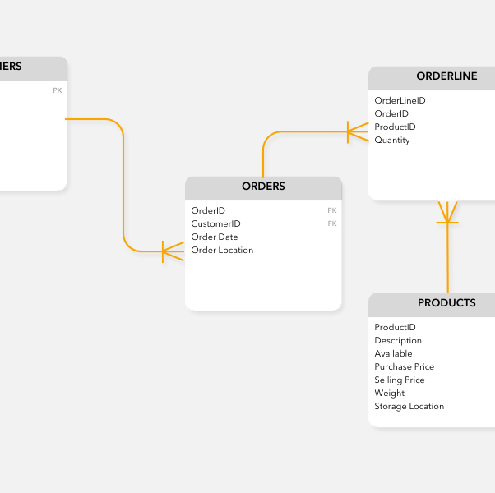
Entity-Relationship Diagrams
Entity Relationship Diagrams (ERD) is the most widely used visual creation tool for Entity Relationship models
ERDs are so widely used because they are capable of being easily normalized
Represent entities as rectangles
Attributes are listed within the rectangle
May exist at multiple layers
Conceptual vs Logical
Depends on level of detail

Slide 41
Why do we need data models?
Used to model data in a standard, consistent, predictable manner in order to manage it as a resource
Guides the development and optimization of data architecture and database design
Supports the effective use and flow of data in various applications
To establish a baseline for communication across functional boundaries within your organization
Provides a shared vocabulary for discussing data across an organization
Serves as a primary communication tool, especially during business process design and database structuring
Provides a basis for defining business rules
To have a clear picture of the base data that your business needs
Streamlines data management by making it more accessible and understandable
To identify missing and redundant data
Helps make the IT solutions upgrade process cheaper, easier, and faster

Slide 42

Database Schema

Slide 43
Database Schema
Definition:
A database schema is the structure or blueprint of a database, defining how data is organized, stored, and related. It includes:
Tables (entities)
Columns (attributes)
Data types
Constraints (primary keys, foreign keys, unique constraints)
Relationships between tables
Why is Schema Design Important?
Ensures data integrity (avoids redundancy and inconsistencies).
Improves query performance and database efficiency.
Supports scalability by structuring data logically.

Slide 44
Data Definition Language (DDL)
DDL is a subset of SQL used to define and manage database schema.
It includes:
CREATE → Creates databases, tables, indexes, and views.
ALTER → Modifies existing tables (add/remove columns, change data types).
DROP → Deletes a table or database.
TRUNCATE → Deletes all data from a table while keeping its structure.

Slide 45
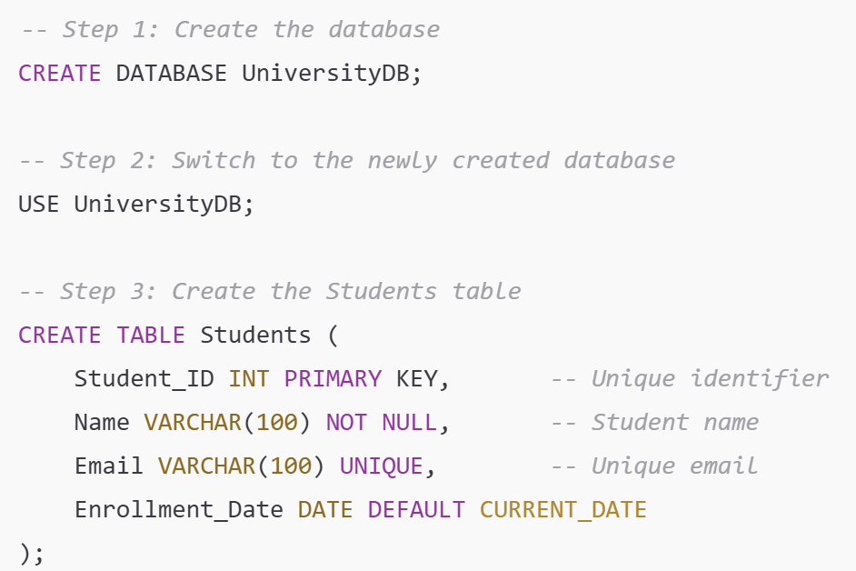

Slide 46
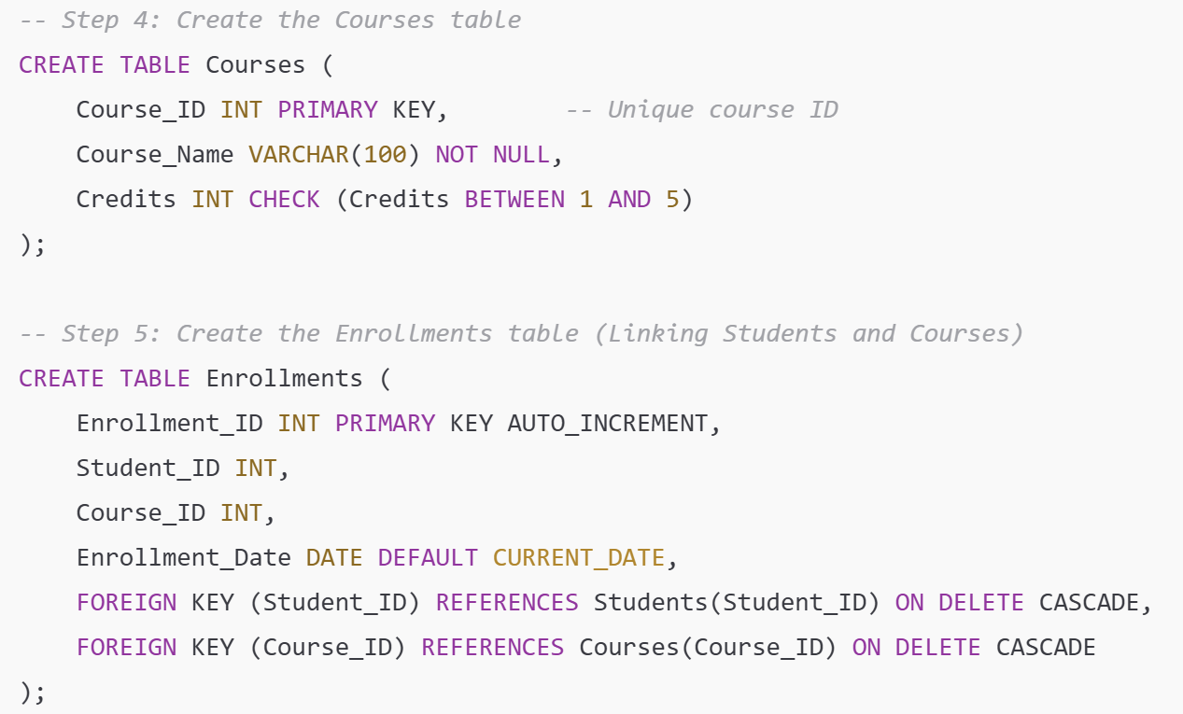

Slide 47
Walkthrough (1)
Steps 1&2: Create a Database
CREATE DATABASE UniversityDB; → Creates a new database named University
DB.USE UniversityDB; → Selects the database to work with.
Step 3: Create the Students Table
Student_ID INT PRIMARY KEY → Ensures each student has a unique ID
Email VARCHAR(100) UNIQUE → Prevents duplicate emails
Enrollment_Date DATE DEFAULT CURRENT_DATE → Sets a default enrollment date

Slide 48
Walkthrough (2)
Step 4: Create the Courses
TableCourse_ID INT PRIMARY KEY → Each course has a unique ID.
Credits INT CHECK (Credits BETWEEN 1 AND 5) → Restricts valid credit values
Step 5: Create the Enrollments Table
Uses a composite relationship between Students and Courses.
FOREIGN KEY (Student_ID) REFERENCES Students(Student_ID) ON DELETE CASCADE → Ensures referential integrity (if a student is deleted, their enrollments are also deleted)
AUTO_INCREMENT for Enrollment_ID generates unique enrollment IDs automatically.

Slide 49


Running the Schema and Viewing the Structure
To see created tables:
To check table structure:

Slide 50
Data Modelling Programs
Tools for drawing ERDs
Automate DDL writing based on ERD
Often supports multiple SQL dialects
Start with logical ERD, deploy multiple physical DDLs
(Somewhat) reconstruct ERD based on DDL

Slide 51
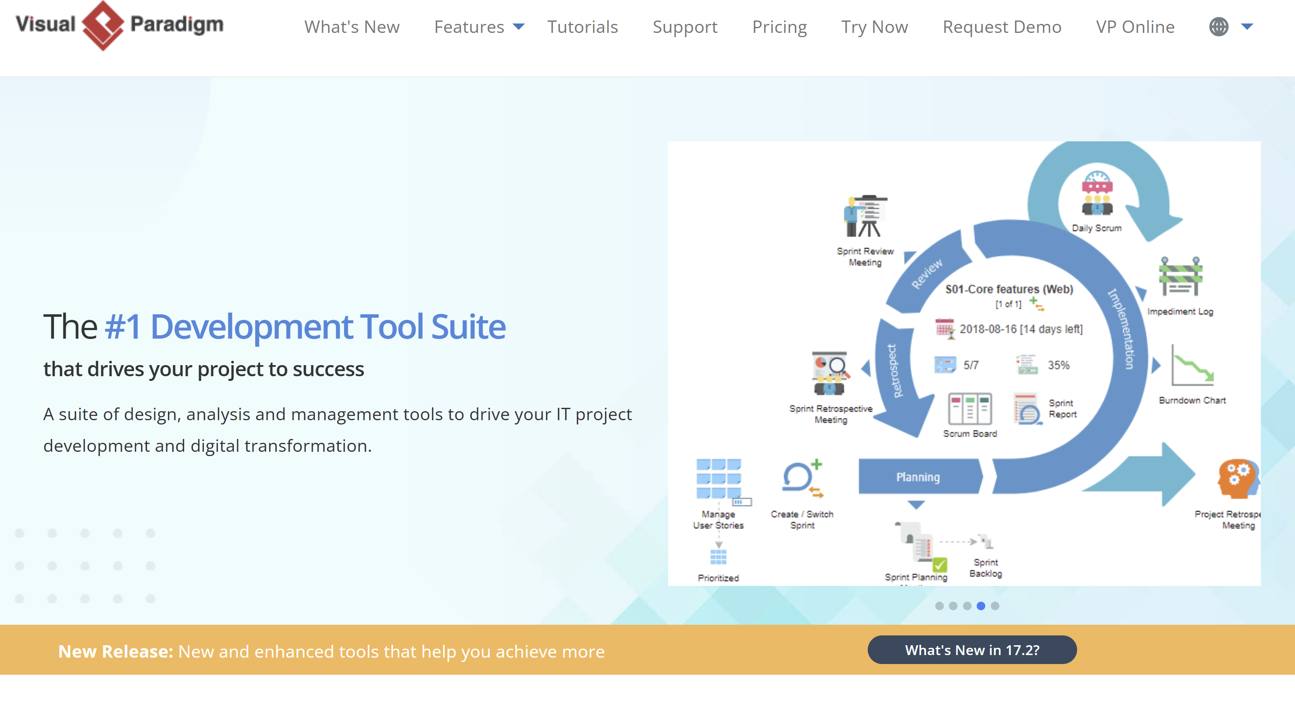
Visual Paradigm

Slide 52
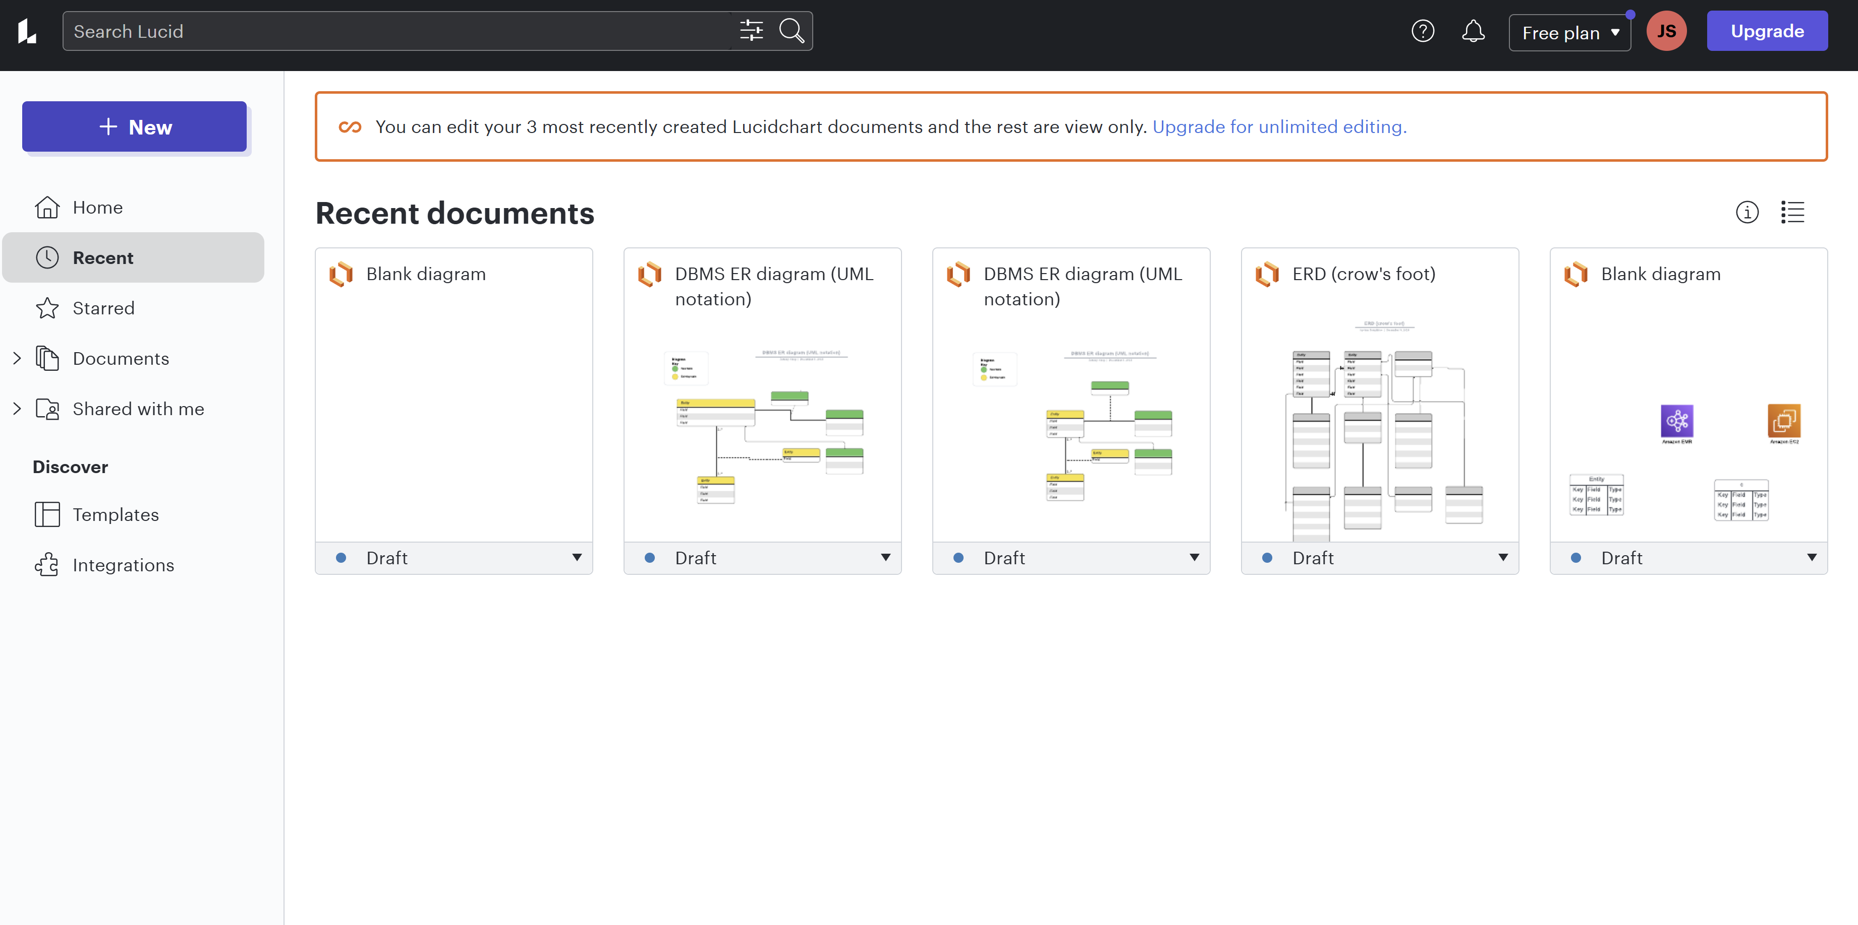
Lucidchart

Slide 53
Joins

Slide 54
SQL Joins
Used to combine tables in various ways
Left (outer) Join
Right (outer) Join
Inner Join
Full Outer Join
Union
Cross Join (rarely used)
“Outer” joins include rows that meet the conditions as well as potentially some that do not
(may have NULLs)
Specify joining table ON joining variables

Slide 55
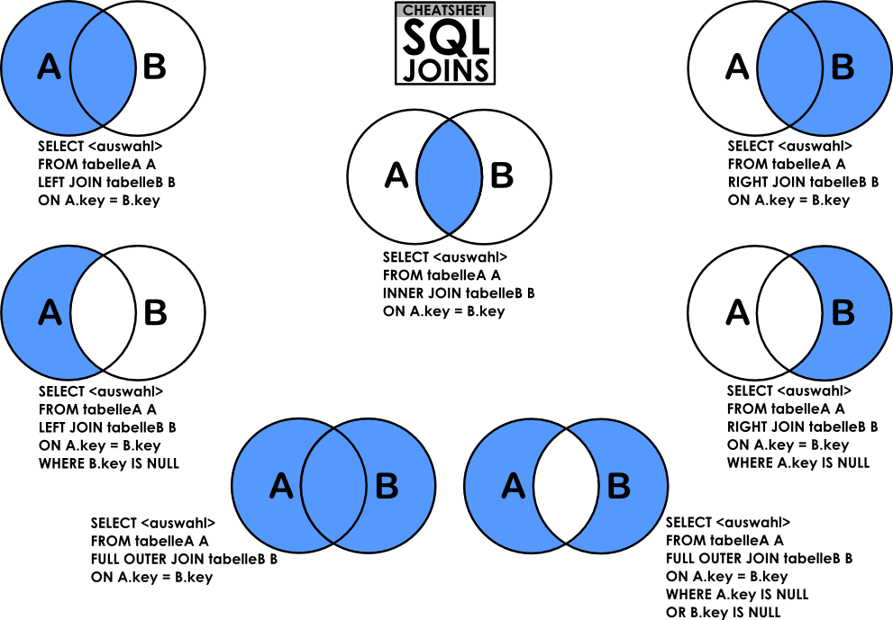

Slide 56
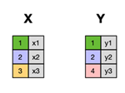
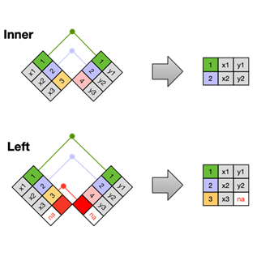
Source: R for Data Science

Slide 57
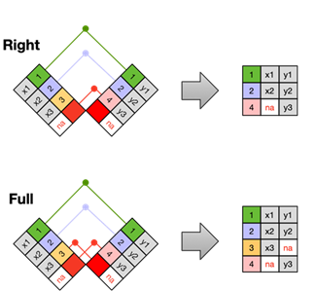
Source: R for Data Science

Slide 58
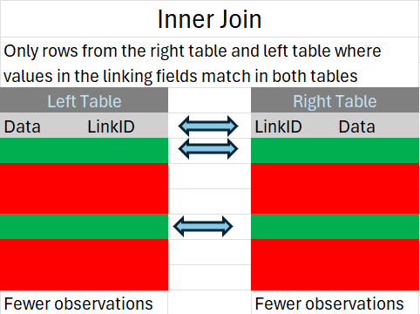
Inner Join
SELECT employees.name, departments.name
FROM employees
INNER JOIN departments ON employees.department_id = departments.id;

Slide 59
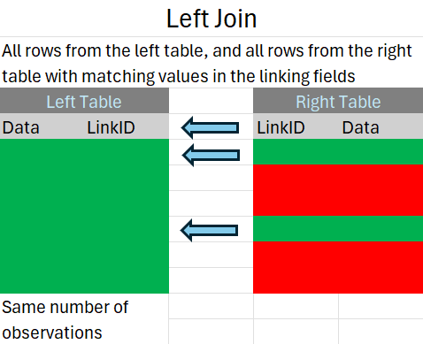
Left (Outer) Join
SELECT students.name, courses.name
FROM students
LEFT JOIN course_enrollments ON students.id = course_enrollments.student_id
LEFT JOIN courses ON course_enrollments.course_id = courses.id;

Slide 60
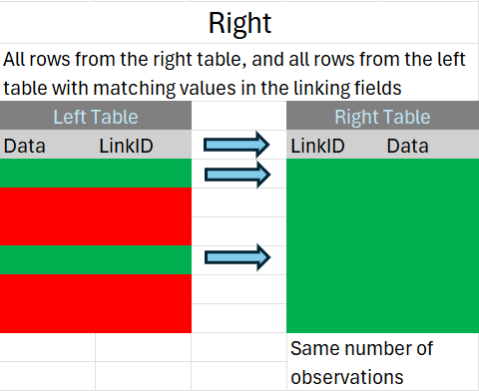
Right (Outer) Join
SELECT column_name(s)
FROM table1
RIGHT JOIN table2
ON table1.column_name = table2.column_name;

Slide 61
FULL OUTER JOIN
The FULL JOIN keyword returns all records when there is a match in either the left (table1) or the right (table2) table records.
Note: Not all database systems support FULL JOIN. For instance, MySQL does not, but you can achieve similar results by combining a LEFT JOIN and a RIGHT JOIN.
Syntax:
SELECT column_name(s)
FROM table1
FULL JOIN table2
ON table1.column_name = table2.column_name;

Slide 62
FULL OUTER JOIN in MySQL
MySQL does not natively support the FULL OUTER JOIN operation, which is commonly found in other relational database management systems like SQL Server or PostgreSQL. However, you can simulate a FULL OUTER JOIN in MySQL using a combination of LEFT JOIN, RIGHT JOIN, and UNION.
To achieve the equivalent of a FULL OUTER JOIN, you can perform a LEFT JOIN and a RIGHT JOIN and then combine the results using UNION. Here's a generic example of how you can simulate a FULL OUTER JOIN in MySQL:
SELECT table1.column1, table2.column2
FROM table1
LEFT JOIN table2 ON table1.common_column = table2.common_column
UNION
SELECT table1.column1, table2.column2
FROM table1
RIGHT JOIN table2 ON table1.common_column = table2.common_column;

Slide 63
Uses of Union
When using this approach, be mindful of how UNION works—it removes duplicate rows.
If you need to include all duplicates, you should use UNION ALL instead.
However, when simulating a FULL OUTER JOIN, duplicates are typically not a concern since the two parts of the UNION target mutually exclusive sets of data (rows that don't match the other table).

Slide 64
Temporary Tables

Slide 65
#temptables
SQL can create temporary tables, that last as long as the SQL session that created them
Designated with #
Can be manually dropped: DROP #mytemptable
Benefits:
Useful for breaking up large operations into smaller steps
Reduce conflicts across sessions
Reduces long-term storage needs

Slide 66
Subqueries
A subquery is a query that is nested inside a main query. Subqueries can occur in various parts of a SQL statement, including the SELECT, FROM, WHERE, and HAVING clauses. They can be used to return data that will be used in the main query for further operations.
Usually enclosed in parenthesis
May return a single value or multiple values
SELECT column1, column2, ...
FROM table1
WHERE column1 = (SELECT column_name FROM table2 WHERE condition);

Slide 67
Common Table Expressions (CTEs)
Temporary tables that exist only for the duration of a query
Thought of as a “named subquery”
Reusable
Can improve readability
Modularize query logic
WITH my_cte AS (
SELECT col1, col2
FROM mytable
WHERE mycondition = TRUE
)
SELECT * FROM my_cte;

Slide 68
Comparing temporary result sets
 | CTEs | Subqueries
Readability | Easier to understand | Harder to understand
Reusability | Can be referenced multiple times | Not reusable
Recursion | Supports recursive queries | Does not support recursive queries

Slide 69
SQL Views
Definition:
A SQL View is a virtual table that does not store data itself but is based on a query.
It allows users to simplify complex queries, restrict access to sensitive data, and improve readability.
Key Characteristics of Views:
Stored Query: A view is created using a SELECT statement and behaves like a table.
No Data Storage: The underlying data remains in the original tables.
Security Control: Can restrict access by exposing only specific columns.
Simplifies Queries: Reduces the complexity of frequently used queries.

Slide 70
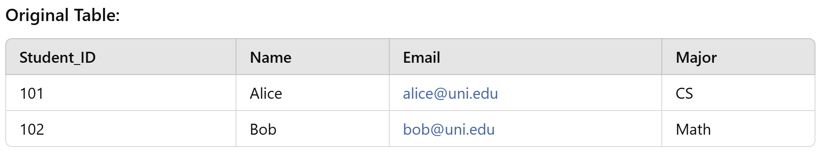
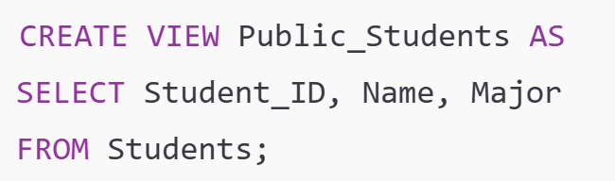
Views: Privacy Example

Slide 71

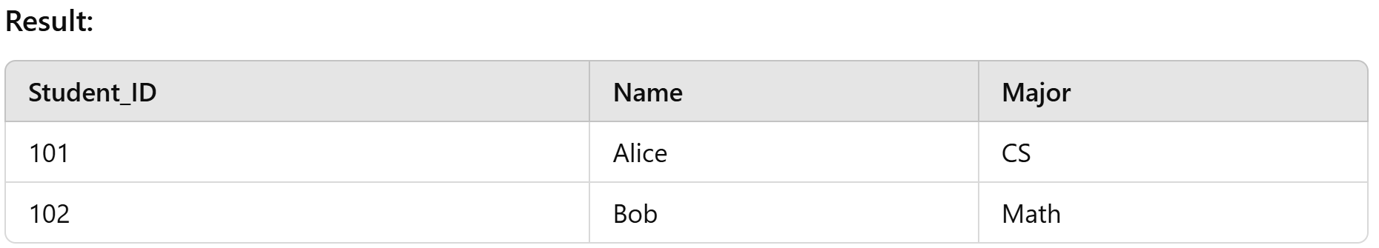
Query the view, while preserving privacy

Slide 72
Indexing
An index is used to speed up the retrieval of rows from a database table.
Without an index, the database has to scan the entire table to find the rows that satisfy a query, which is called a full table scan.
Faster write
With an index, the database can greatly reduce the number of read operations, as the index contains a smaller subset of data and provides a direct path to the data that satisfies the query.
Slower write
CREATE INDEX idx_employees_department_id
ON employees (department_id);

Slide 73

Data Engineering vs Data Science

Slide 74

Databases to OLAP Cubes
In large-scale data analysis, data often moves between operational databases and analytical systems (OLAP cubes). This section explains why and how this transition happens.
ETL Process (Extract, Transform, Load)
Extract → Data is pulled from OLTP databases
Transform → Data is cleaned, aggregated, and restructured
Load → Data is inserted into OLAP systems for analysis.

Slide 75
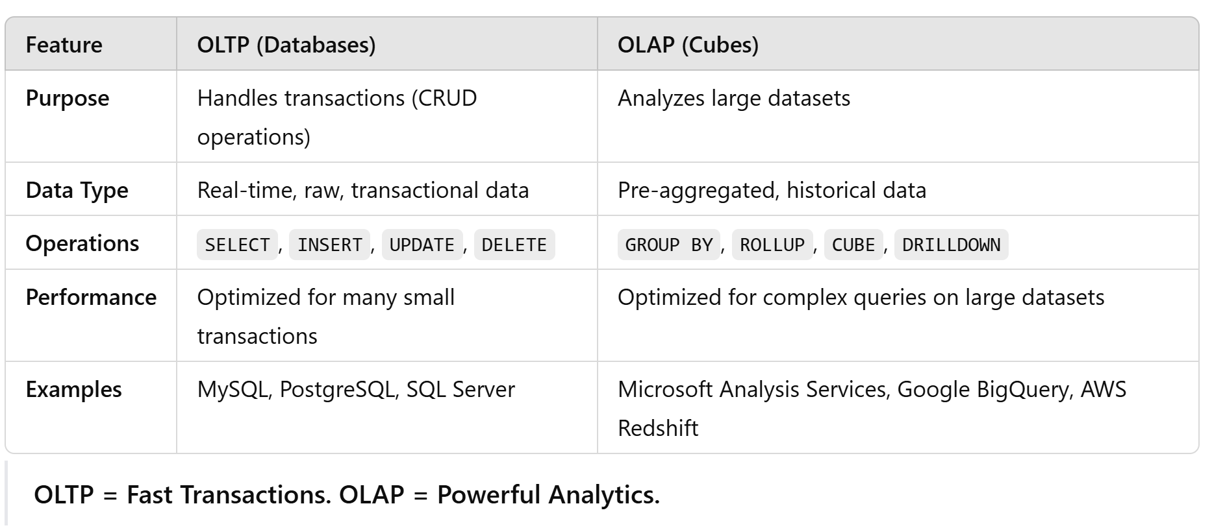

Slide 76

When to Use Databases and OLAP Cubes
Use a Relational Database (OLTP):
You need fast transactional processing (banking, e-commerce)
You perform CRUD operations (inserting/updating/deleting records)
You need normalized data for consistency
Use an OLAP Cube:
You perform historical and analytical reporting
You need pre-aggregated summaries for fast queries
You require complex data models with ROLLUP, CUBE, and DRILLDOWN

Slide 77
Takeaways
Relational Databases Are Structured for Efficiency and Integrity
Relational databases organize data into tables with relationships, ensuring consistency, accuracy, and scalability.
Normalization helps reduce redundancy and maintain data integrity, but sometimes denormalization is necessary for performance.
Entity-Relationship Diagrams (ERDs) are critical for designing a well-structured database before implementation.
Schema Design and SQL Queries Shape How Data Is Used
Good schema design (using primary keys, foreign keys, and constraints) impacts data retrieval speed, integrity, and usability.
Joins allow us to combine tables and extract meaningful insights, while subqueries, CTEs, and views simplify complex queries.
Data Definition Language (DDL) helps define, modify, and manage database structure efficiently.
Turning Raw Data into a Relational Database Requires Thoughtful Design and Querying
Importing raw CSV data into a structured relational database involves designing a schema, cleaning data, and writing SQL scripts.
Properly structuring data improves query performance and decision-making in public policy and real-world applications.
SQL isn't just for querying data—it’s a tool for structuring, securing, and optimizing data workflows.

Slide 78
Next Week
AWS RDS?
RedShift/Sagemaker?

